Slide 1
Final Business Pitch
Lylybeth Arambula, Joseline Martinez, Christianna Webster & Cameron Hunter

Slide 2
Agenda
Description & Vision
Industry
Target Market
Competitors
Product
Marketing Plan
Future of IEM Body
Operations
Financial Plan
Why IEM Body?

Slide 3
Description & Vision
IEM Body is dedicated to promoting body positivity and wellness
Strive to create a ripple effect through our name, “I am”, encouraging individuals to be confident in their own skin
Can tailor their body care routine to reach their skin goals
Customizable pods and body washes cater to a diverse range of skincare concerns
Allow our customers to personalize their experience and fall in love with their self-care routine all over again
Values include inclusivity, quality, effectiveness, affordability, and body positivity
100% sustainable and use eco-friendly practices when sourcing ingredients and packaging materials
“For self-loving women who seek skin nourishing products, IEM Body is the body care brand that offers a range of high quality, personalized body wash products that attend to the skin needs of every customer while remaining ethical and sustainable.”

Slide 4
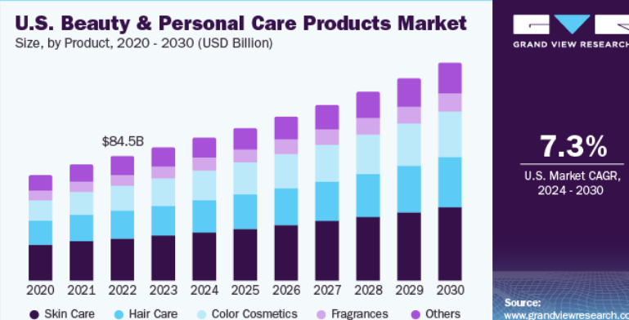
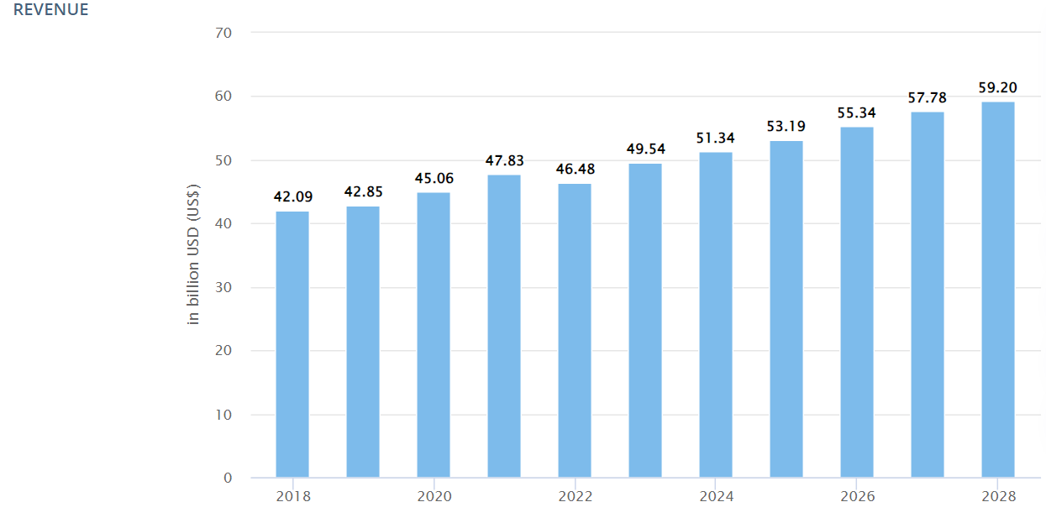
Industry
, clean
Consumers becoming more conscious of ingredients and are seeking clean body care products
Body care has become the new form of skin care
Personalization within products are at a higher demand
Consumers seek hydrating, brightening and moisture retention within their products
Multi-use products
Body care industry expected to grow 7.4% - 7.7% (2024-2030)
Gen Z and Millennials hold the strongest purchasing power
Gen Z: $44 billion in buying power in just the US
Millennials: world's largest adult generation and biggest beauty spenders
Opportunity: Big corporations are falling through by not being innovative and formulating products that appeal to most recent generations
IEM BODY
Notes:
JOSELINE

Slide 5
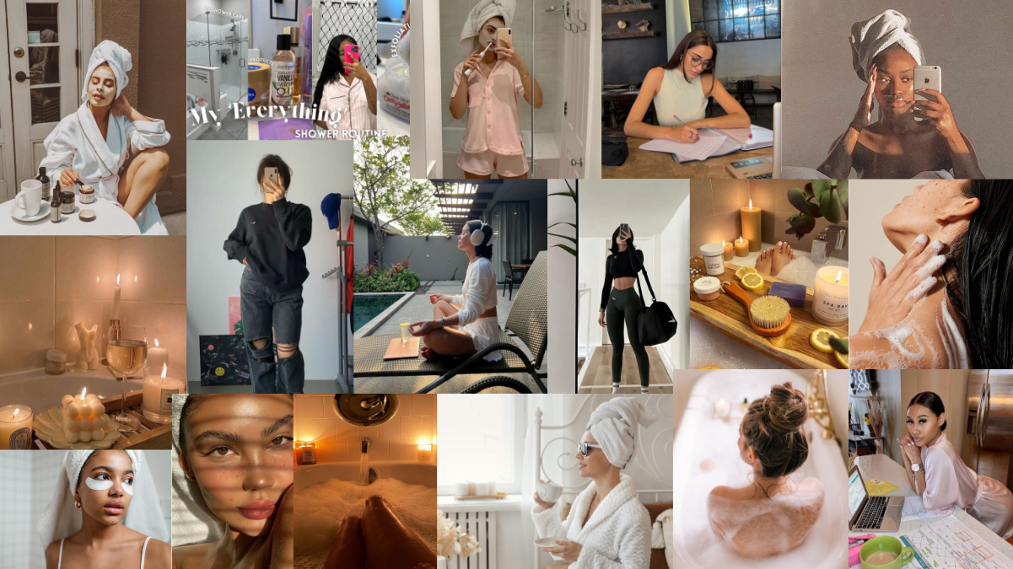
Target Market
Gen Z & Millennials
Demographics:
Women
Ages: 18-30
All ethnicities and races
No education required
Disposable income
Behaviors:
Purpose driven
Practice and value individuality
Seek personalized products
Value shopping experience
Psychographics:
Advocates for body positivity
Journey to self-love and empowerment
Beauty lovers
Indulge in self-care practices
Geographic:
Within the U.S.
Urban and rural areas
Notes:
JOSELINE

Slide 6
Competitors
Fast-growing, affordable skincare brand
Plant-sourced, high-performance skincare products
Clinically effective, skin-compatible, and affordable
Use innovative alternatives and advanced science
Target market: Older millennials (27 to 42 years old
Cost: range from $10 to $34
Launched at the end of 2018 with only body care products
Have expanded its product portfolio with hair and face products
innovative approach to their ingredients
awarded the Seal Of Acceptance by the National Eczema Association
Genderless body care line, cater to all genders
Cost: range from $15 to $55
Affordable and eco-conscious body care brand
Inclusive, affordable, and sustainable
Create sensory experience with "exotic" ingredients
Sustainably packaged in 100% aluminum bottles with sugar cane-derived tubes
Target Market: Millennial women
Cost: range from $5 to $20
Notes:
LYLY

Slide 7
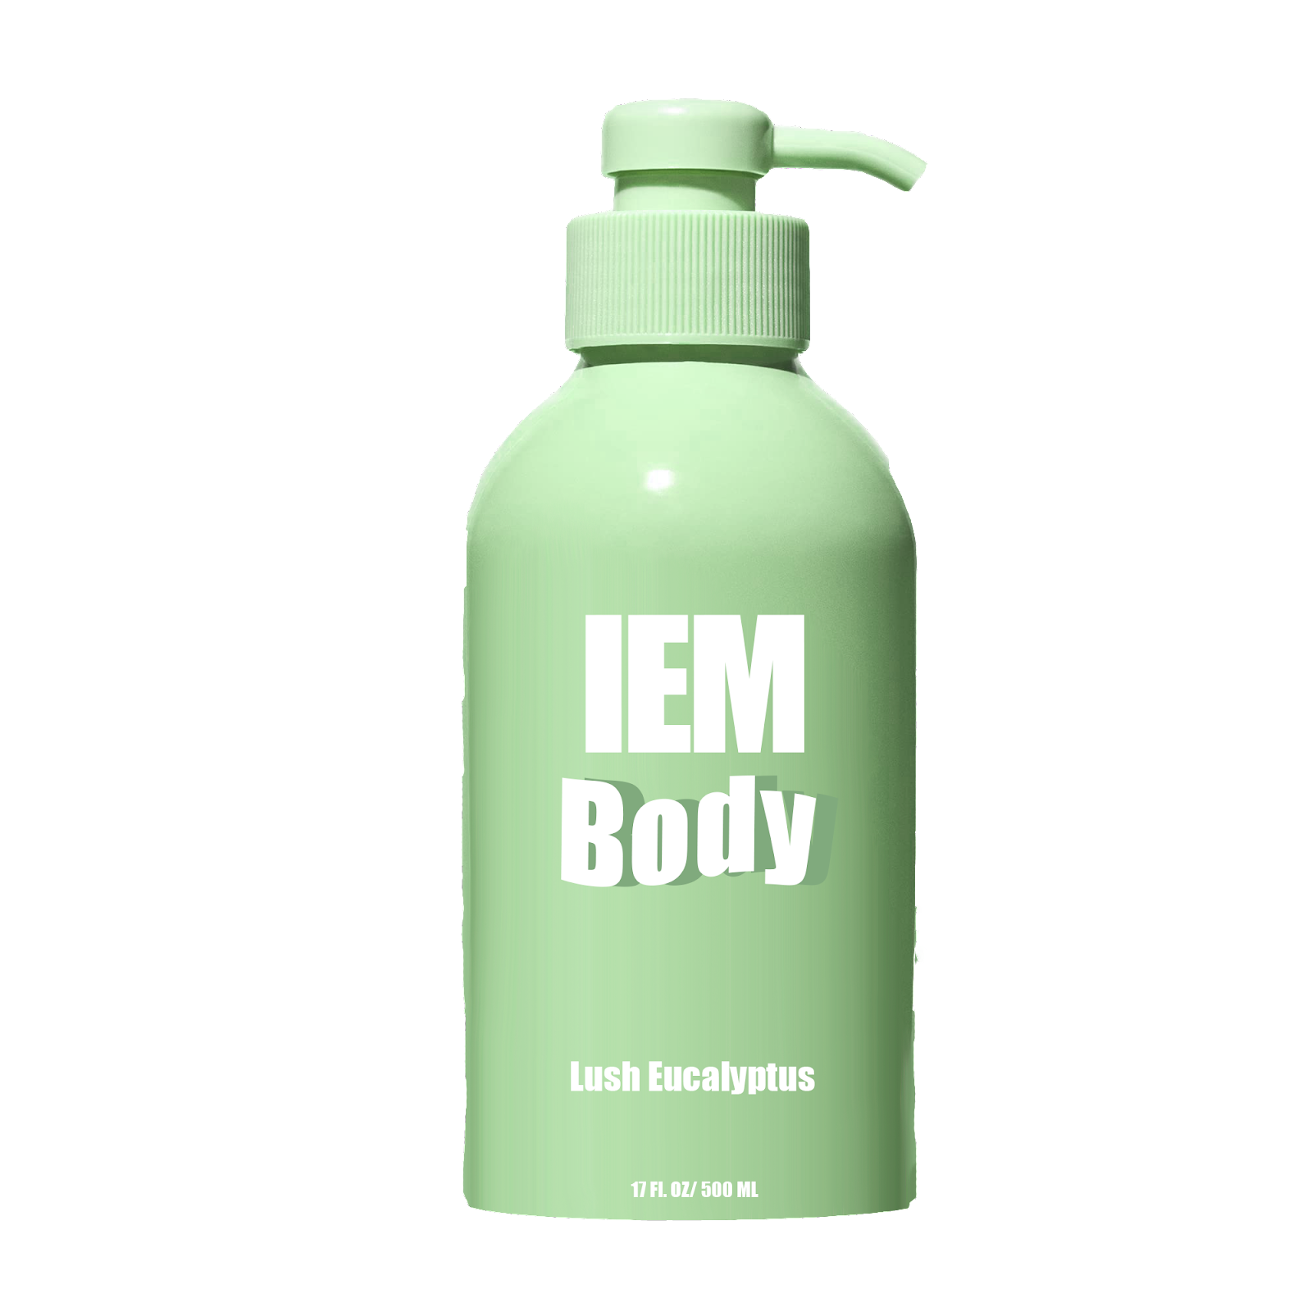
Product
Ten body washes/scents:
Rose (red bottle)
Honey Orange (orange bottle)
Lemonade (yellow bottle)
Lush Eucalyptus (green bottle)
Ocean Escape (blue bottle)
Lily Lavender (lavender bottle)
Vanilla Hibiscus (pink bottle)
Cedar Woods (black bottle)
Salted Caramel and Coconut (brown bottle)
Fragrance-Free (white bottle)
Packaging:
On every body wash bottle, there is a unique positive affirmation that is placed on the back
Body Wash:
No secondary packaging
Primary packaging is made of recyclable aluminum
Secondary packaging is made of compostable recycled paper
Primary packaging is made from sugar cane and corn starch which is biodegradable
Five customizable pods:
Skin Moisturizing Pod (brown pod)
Skin Renewing Pod (blue pod)
Skin Balancing Pod (green pod)
Skin Brightening Pod (orange pod)
Skin Energizing Pod (yellow pod)
Cost
Body Wash: $11.99 USD
Customizable Pod: $4.99 USD
Notes:
CHRISTIANNA

Slide 8
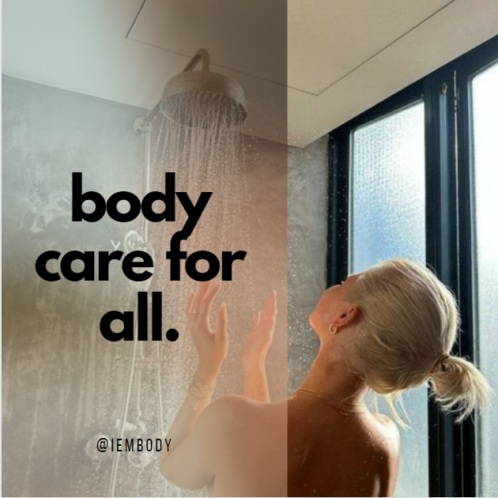
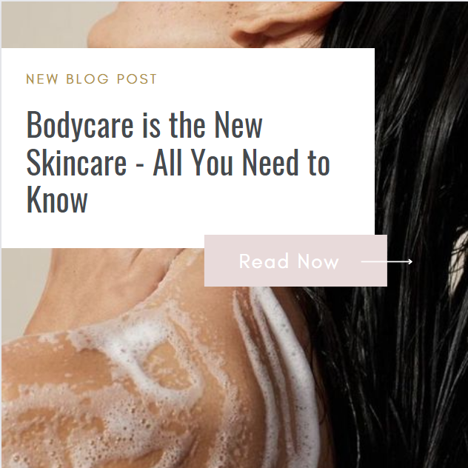
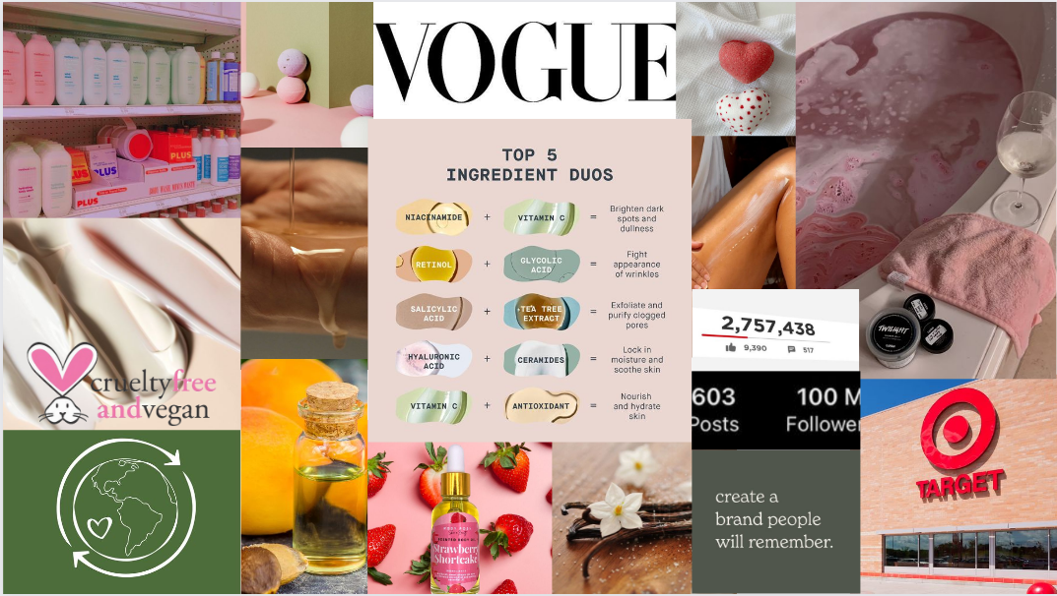
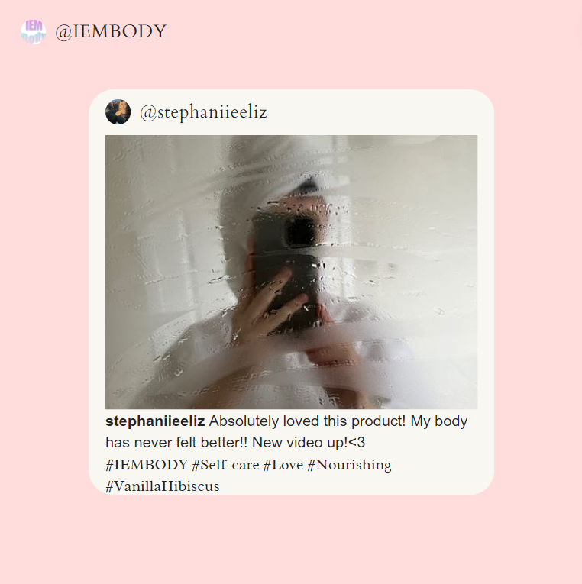
Marketing Plan
Full E-Commerce Business Model
Social Media Platforms
Instagram, TikTok, and YouTube
IEM Body Website
Ads
SEO
UGC
Pop-up Events and campaigns
Content:
Blog Posts
Instagram stories and posts
Magazine Ads

Slide 9
Future of IEM Body

Slide 10
Operations
Product Design
Body wash made from recycled aluminum bottles and the pump will be PCR plastic, pods will be biodegradable and compostable
Logistics
Will be manufactured in LA near our office and products will be transported to our warehouse for quality control check
Service & Retail
Distribution team to ensure shopping, shipping and delivery system runs smoothly
Service Promise
Location
Offer phone support M-F from 9am to 6pm PST, answer emails from 24 to 48 hours, provide free returns and exchanges and provide an email newsletter
Start off as a DTC business and will invest in an office and product development facilities to operate in LA

Slide 11
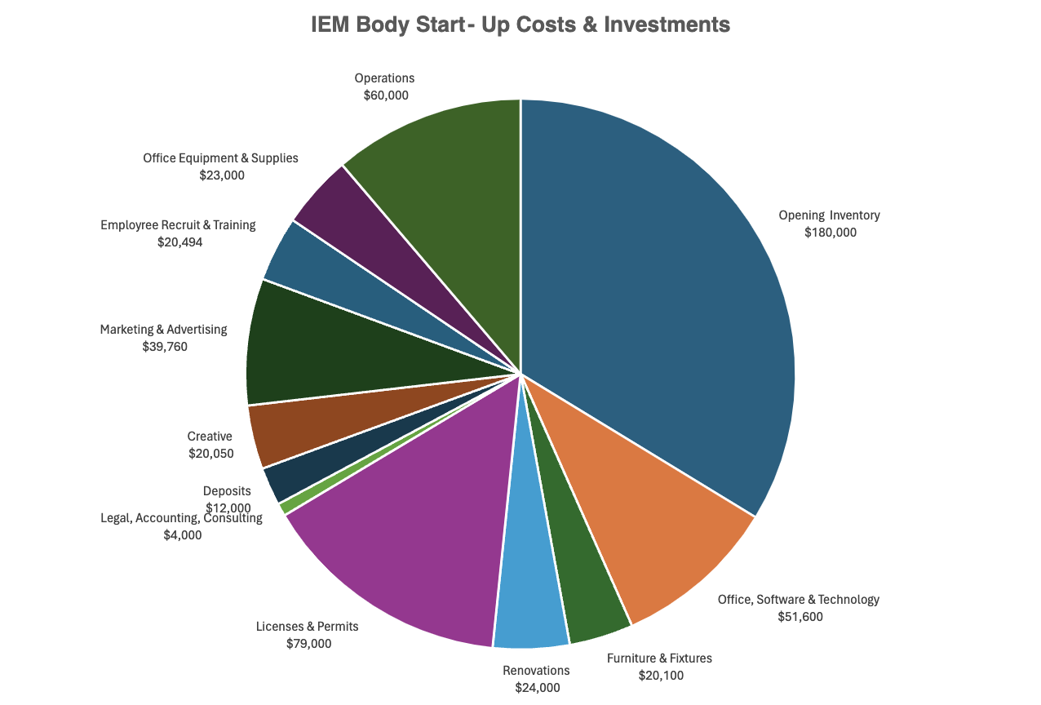
Financial Plan Chart
Initial expense breakdown $534,000, asking for $700,000
Additional $166,000 is for potential unforeseen costs not accounted for
Evaluated the company using Projected Revenue multiple
Projected revenue at the end of year one is $1,020,650, and based off the industry average revenue multiple, the companies value was calculated to be roughly 2,.5 million dollars
Calculated that 700,000 initial capital would be worth 28% equity in IEM beauty this will be sold to the investor through common stock
Notes:
Cameron

Slide 12
Why IEM Body?
Wide range of options regarding products.
IEM Body places the consumer at the forefront of decision-making
Bodycare is a booming business amongst Gen Z and Millennials.
Positive affirmations help instill confidence
Sustainability efforts
Experience of personalization is offered
Quality over quantity
As founders, we resonate with our consumers and know first-hand what is needed within the market

Slide 13
Thank you!
IEM Body Team
support@iembody.com

